Slide 1
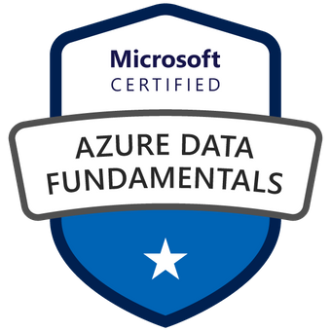

Exam DP-900: Microsoft Azure Data Fundamentals Crash Course
Tim Warner

Slide 2


Tim Warner
Based in Nashville, TN, US
Central time zone
MCT, MVP
Twitter: @TechTrainerTim
Badge: TechTrainerTim.com

Slide 3
Session 1 of 2 Agenda
Introduction
Core Data Concepts
Non-Relational Data
Relational Data (start)

Slide 4
Session 2 of 2 Agenda
Content catch-up
Relational Data (finish)
Data Analytics
Exam DP-900 strategy

Slide 5
Course Materials
timw.info/dp900

Slide 6
A Different Kind of Training
We'll learn by doing – at least 80 percent demo
Visual, case study approach
This is an expert certification, so we will move quickly and assume intermediate-level Azure skills
5-minute break at midpoint
I’m here to answer your questions – take advantage of this!
Use the Q&A panel

Slide 7

Session Recordings

Slide 8

Session Recordings

Slide 9

Session Recordings

Slide 10
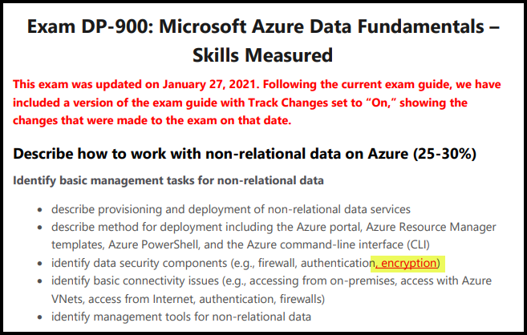
DP-900 Changes: January 27, 2021

Slide 11
Tim's Certification Study Pyramid
Interdependence
Content knowledge
Practical application
Test-taking skills

Slide 12
Thank you!
Course materials: timw.info/dp900
Twitter: @TechTrainerTim
Work: timw.info/ps
Web: TechTrainerTim.com

Slide 13
Core Data Concepts

Slide 14
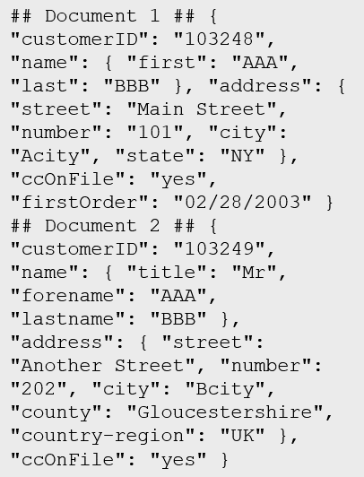
Data Types
Structured
Semi-structured
Unstructured
Table

Slide 15

Data Workload Types
Online Transactional Processing (OLTP)
Online Analytical Processing (OLAP)
Customer
CustomerID | CustomerName | CustomerPhone
Orders
OrderID | CustomerID | OrderDate
Data is periodically loaded, aggregated and stored in a cube
Data is stored one transaction at a time

Slide 16
Transactional workloads
Account
CustomerID | Balance
5558 | 500
6023 | 2000
Customer
CustomerID | CustomerName | CustomerPhone
Account
CustomerID | Balance
5558 | 1000
6023 | 1500
Orders
OrderID | CustomerID | OrderDate
Transfers
TransactionID | FromAccount | ToAccount | Transaction Amount | OrderDate | TransactionDescription
Transfers
TransactionID | FromAccount | ToAccount | Transaction Amount | OrderDate | TransactionDescription
982801 | 6023 | 5558 | 500 | DD/MM/YY | Transfer 500 from account 6023 to account
BEGIN TRANSACTION
UPDATE Account
SET Balance = Balance -500
WHERE CustomerID=6023;
UPDATE Account
SET Balance = Balance +500
WHERE CustomerID=5558;
INSERT INTO Transfers (Fromaccount, ToAccount, TransactionAmount,TransactionDescription) VALUES (6023,5558,500,’Transfer 500 from account 6023 to account 5558)
COMMIT TRANSACTIONTransaction
Notes:
Instructor notes
Ensure that students understand ACID:
*Atomicity* guarantees that each transaction is treated as a single *unit*, which either succeeds completely, or fails completely.
*Consistency* ensures that a transaction can only take the data in the database from one valid state to another.
*Isolation* ensures that concurrent execution of transactions leaves the database in the same state that would have been obtained if the transactions were executed sequentially.
*Durability* guarantees that once a transaction has been committed, it will remain committed even if there's a system failure such as a power outage or crash.

Slide 17





Analytical system
On-premises data
SQL Server, Oracle, fileshares, SAP
Data ingestion
Data storage
Data processing
Data visualization
Cloud data
Azure, AWS, GCP
SaaS data
Salesforce, Dynamics
Notes:
Instructor notes
Analytical workloads are typically read-only systems that store vast volumes of historical data or business metrics
Analytics can be based on a snapshot of the data at a given point in time, or a series of snapshots.
An example of analytical information is a report on monthly sales.

Slide 18

Batch data/streaming data
Batch
Streaming
Notes:
Instructor notes
Batch processing
In batch processing, newly arriving data elements are collected into a group. The whole group is then processed at a future time as a batch.
Streaming
With streaming data newly arrived elements are processed in real-time
Differences between batch and streaming
- *Data Scope*: Batch processing can process all the data in the dataset. Stream processing typically only has access to the most recent data received, or within a rolling time window (the last 30 seconds, for example).
- *Data Size*: Batch processing is suitable for handling large datasets efficiently. Stream processing is intended for individual records or *micro batches* consisting of few records.
- *Performance*: The latency for batch processing is typically a few hours. Stream processing typically occurs immediately, with latency in the order of seconds or milliseconds. Latency is the time taken for the data to be received and processed.
- *Analysis*: You typically use batch processing for performing complex analytics. Stream processing is used for simple response functions, aggregates, or calculations such as rolling averages.

Slide 19
Data Types

Slide 20
Data Formats - JSON

Slide 21
Non-Relational Data

Slide 22
Explore characteristics of non-relational data
Entities
## Customer 1 ID: 1
Name: Mark Hanson
Telephone: [ Home: 1-999-9999999, Business: 1-888-8888888, Cell: 1-777- 7777777 ]
Address: [ Home: 121 Main Street, Some City, NY, 10110,
Business: 87 Big Building, Some City, NY, 10111 ]
## Customer 2 ID: 2
Title: Mr
Name: Jeff Hay
Telephone: [ Home: 0044-1999-333333, Mobile: 0044-17545-444444 ]
Address: [ UK: 86 High Street, Some Town, A County, GL8888, UK,
US: 777 7th Street, Another City, CA, 90111 ]
Non-relational collections can have:
Multiple entities in the same collection or container with different fields
Have a different, non-tabular schema
Are often defined by labeling each field with the name it represents
Notes:
Instructor notes
Data doesn’t follow rules of relational data.
Because data can be loaded in its native form, it can be loaded quickly.
Very flexible and good for unknown data or queries.
Less good for known data structures and known queries.

Slide 23

Identify non-relational database use cases
IoT and Telematics:
Often require to ingest large amounts of data in frequent burst of activity, data is either semi structured or structured, often requires real time processing
Retail and Marketing:
Common scenarios for globally distributed data, document storage
Gaming:
In-game stats, social media integration, leaderboards, low-latency applications
Web and Mobile:
Commonly used with web click analytics, modern applications including bots

Slide 24
Types of non-relational data
What is semi-structured data?
Data structure is defined within the actual data by fields. Format/file types include:
JSON
AVRO
ORC
Parquet
Notes:
Instructor notes
A JSON document is enclosed in curly brackets ({ and }). Each field has a name (a label), followed by a colon, and then the value of the field. Fields can contain simple values, or subdocuments (each starting and ending with curly brackets). Fields can also have multiple values, held as arrays and surrounded with square brackets ([ and ]).
Avro is a row-based format. It was created by Apache. Each record contains a header that describes the structure of the data in the record. This header is stored as JSON. The data is stored as binary information. An application uses the information in the header to parse the binary data and extract the fields it contains. Avro is a very good format for compressing data and minimizing storage and network bandwidth requirements.
ORC (Optimized Row Columnar format) organizes data into columns rather than rows. It was developed by HortonWorks for optimizing read and write operations in Apache Hive. Hive is a data warehouse system that supports fast data summarization and querying over very large datasets.
Parquet is another columnar data format. It was created by Cloudera and Twitter. A Parquet file contains row groups. Data for each column is stored together in the same row group. Each row group contains one or more chunks of data. A Parquet file includes metadata that describes the set of rows found in each chunk.

Slide 25
What is unstructured data?
Does not naturally contain fields:
Examples: video, audio, media streams, documents
Often used to extract data organization and categorize or identify “structures”
Frequently used in combination with Machine Learning or Cognitive Services capabilities to “extract data” by using:
Text Analytics
Sentiment Analysis with Cognitive APIs
Vision API

Slide 26
What is NoSQL?
Loose term, to describe non-relational
Key-value stores
Document based
Column family databases
Graph Databases
Notes:
Instructor notes
Key value store. Each data item in a key-value store has two elements, a key and a value. The key uniquely identifies the item, and the value holds the data for the item.
A document database represents the opposite end of the NoSQL spectrum from a key-value store.
In a document database, each document has a unique ID, but the fields in the documents are transparent to the database management system.
Document databases typically store data in JSON format, as described in the previous unit, or they could be encoded using other formats such as XML, YAML, JSON, BSON.
Documents could even be stored as plain text.
A column family database organizes data into rows and columns. Examples of this structure include ORC and Parquet files, described in the previous unit.
Graph databases are discussed in subsequent slides.

Slide 27

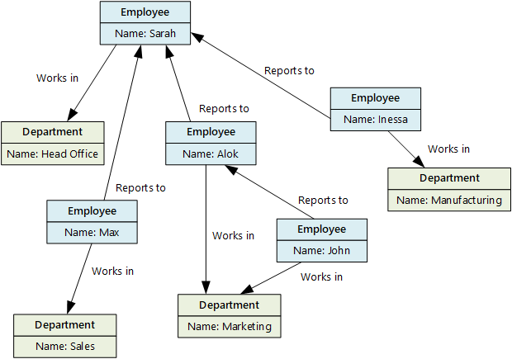

What is a graph database?
Stores entities centric around relationships
Enables applications to perform queries traversing a network of nodes and edges
Notes:
Instructor notes
Graph databases enable you to store entities, but the main focus is on the relationships that these entities have with each other. A graph database stores two types of information: nodes that you can think of as instances of entities, and edges, which specify the relationships between nodes.

Slide 28
What applications require a graph database?
Business requirements:
OLTP apps with highly correlated data
Easy updates to single or many objects
Flexible data modelling
Data requirements that evolve
Hierarchical data structures

Slide 29
Explore Azure Table storage
Key (Customer ID)
Value (Customer Data)
C1
AAAAA
BBB
101 Block Street
YY
999
888
C2
MM
NN
21 A Street
5 B Avenue
C3
DDD
EEE
FFF
111
222
66 C Road
Notes:
Instructor notes
All rows in a table must have a key, but apart from that the columns in each row can vary. Unlike traditional relational databases, Azure Table Storage tables have no concept of relationships, stored procedures, secondary indexes, or foreign keys. Data will usually be denormalized, with each row holding the entire data for a logical entity.

Slide 30
Explore Azure Blob storage
Block blobs
Page blobs
Append blobs
Has a maximum size of 4.7TB
Best for storing large, discrete, binary objects that changes infrequently
Each individual block can store up to 100MB of data
A block blob can contain up to 50000 blocks
Can hold up to 8TB of data
Is organized as a collection of fixed sized-512 byte pages
Used to implement virtual disk storage for virtual machines
The maximum size is just over 195GB
Is a block blob that is used to optimize append operations
Each individual block can store up to 4MB of data
Notes:
Instructor notes
Azure Blob storage is a service that enables you to store massive amounts of unstructured data, or Binary Large OBjects, in the cloud.
Azure currently supports three different types of blob:
Block blobs. A block blob is handled as a set of blocks. Each block can vary in size, up to 100 MB. A block blob can contain up to 50,000 blocks, giving a maximum size of over 4.7 TB. The block is the smallest amount of data that can be read or written as an individual unit. Block blobs are best used to store discrete, large, binary objects that change infrequently.
Page blobs. A page blob is organized as a collection of fixed size 512-byte pages. A page blob is optimized to support random read and write operations; you can fetch and store data for a single page if necessary. A page blob can hold up to 8 TB of data. Azure uses page blobs to implement virtual disk storage for virtual machines.
Append blobs. An append blob is a block blob optimized to support append operations. You can only add blocks to the end of an append blob; updating or deleting existing blocks isn't supported. Each block can vary in size, up to 4 MB. The maximum size of an append blob is just over 195 GB.

Slide 31
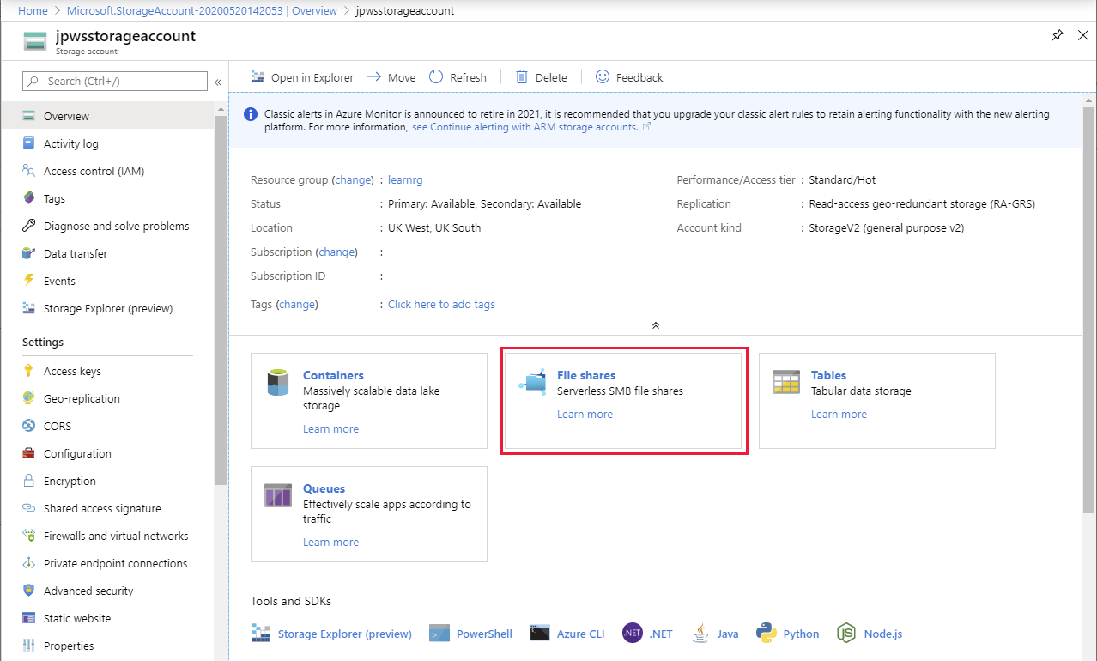
Explore Azure File storage
Notes:
Instructor notes
Azure File Storage is cloud-based SMB 3.0 storage. This makes it widely supported and globally accessible.

Slide 32
Explore Azure Cosmos DB
Scalability
Performance
Availability
Programming model
Notes:
Instructor notes
Note: This is covered in more detail in Lesson 3.
Azure Cosmos DB is a multi-model NoSQL database management system enabling you to store and query data more easily.
Cosmos DB includes multiple APIs that present different interfaces and make Cosmos DB compatible with a wide variety of platforms.

Slide 33
Use cases for Azure Cosmos DB
Web and retail
Gaming
IoT scenarios
Using Azure Cosmos DB’s multi-master replication model along with Microsoft’s performance commitments, Data Engineers can implement a data architecture to support web and mobile applications that achieve less than a 10-ms response time anywhere in the world
The database tier is a crucial component of gaming applications. Modern games perform graphical processing on mobile/console clients but rely on the cloud to deliver customized and personalized content like in-game stats, social media integration, and high-score leader boards
Hundreds of thousands of devices have been designed and sold to generate sensor data known as Internet of Things (IoT) devices. Using technologies like Azure IoT Hub, Data Engineers can easily design a data solution architecture that captures real-time data. Cosmos DB can accept and store this information very quickly
Notes:
Instructor notes
Use cases and management benefits of using Azure Cosmos DB
Cosmos DB is a highly scalable database management system. Each partition can grow up to 10 GB in size.
Indexes are created and maintained automatically.
All databases are replicated within a single region (or across regions at additional cost)
Cosmos DB guarantees 99.99% high availability.
Cosmos DB guarantees less than 10-ms latencies for both reads (indexed) and writes at the 99th percentile, all around the world.
Cosmos DB is highly suitable for the following scenarios:
- IoT and telematics - Retail and marketing
Gaming
Web and mobile applications

Slide 34
Cosmos DB APIs
SQL API
Table API
MongoDB API
Cassandra API
Gremlin API
Supports SQL-like query language
Compatible with Azure Table Storage
Compatible with MongoDB
Compatible with Cassandra
A graph database
Notes:
Instructor notes
Azure Cosmos DB is a multi-model NoSQL database management system enabling you to store and query data more easily.
Cosmos DB includes multiple APIs that present different interfaces and make Cosmos DB compatible with a wide variety of platforms. The APIs that Cosmos DB currently supports include:
SQL API – supports SQL-like query language
Table API – compatible with Azure Table Storage
MongoDB API – compatible with MongoDB
Cassandra API – compatible with Cassandra
Gremlin API – a graph database
New applications should use the SQL API, but the other APIs enable straightforward migration of existing systems.

Slide 35
Query Azure Cosmos DB
COUNT( <fields_to_count> )
SUM( <numeric_fields> )
AVG( <numeric_fields> )
MAX( <numeric_fields> )
MIN( <numeric_fields> )
Aggregation Function Basics
SQL API examples
SELECT COUNT(*) FROM Products p
SELECT SUM(p.quantity) FROM Products p
WHERE p.expired = 0
SELECT AVG(p.price) AS ‘Average Price’
FROM Products p
SELECT p1.ID, p.Name, p1.Description, p1.Price FROM Products p1
WHERE p1.Price = (SELECT MIN(p2.Price) FROM Product p2)
Notes:
Instructor notes
Understand aggregate functions
You can use aggregate functions to summarize data in SELECT queries; you place aggregate functions in the SELECT clause. The SQL API query language supports the following aggregate functions:
COUNT(p). This function returns a count of the number of instances of field p in the result set. To count all the items in the result set, set p to a scalar value, such as 1.
SUM(p). This function returns the sum of all the instances of field p in the result set. The values of p must be numeric.
AVG(p). This function returns the mathematical mean of all the instances of field p in the result set. The values of p must be numeric.
MAX(p). This function returns the maximum value of field p in the result set.
MIN(p). This function returns the minimum value of field p in the result set.
Although the syntax of aggregate functions is similar to ANSI SQL, unlike ANSI SQL the SQL API query language doesn't support the GROUP BY clause; you can't generate subtotals for different values of the same field in a single query. You're able to include more than one aggregate function in the SELECT clause of your queries.
[Demo with the Volcanoes Data]
// Find the total number of volcanoes in Japan
SELECT COUNT(v) AS totalVolcanoesJapan
FROM v
WHERE v.Region = "Japan“
// Find the deepest volcano in Japan
SELECT MAX(v.Elevation) AS deepestVolcanoJapan
FROM v
WHERE v.Region = "Japan"

Slide 36
Relational Data

Slide 37
Identify relational database use cases
IoT:
Although typically considered for non-relational, the data from IoT devices could be structured and consistent
Online transaction processing:
For example order systems that perform many small transactional updates
Data warehousing:
Large amounts of data can be imported from multiple sources and structured to enable high-performance queries

Slide 38
Tables
Customers
CustomerID | CustomerName | CustomerPhone
100 | Muisto Linna | XXX-XXX-XXXX
101 | Noam Maoz | XXX-XXX-XXXX
102 | Vanja Matkovic | XXX-XXX-XXXX
103 | Qamar Mounir | XXX-XXX-XXXX
104 | Zhenis Omar | XXX-XXX-XXXX
105 | Claude Paulet | XXX-XXX-XXXX
106 | Alex Pettersen | XXX-XXX-XXXX
107 | Francis Ribeiro | XXX-XXX-XXXX
Data is stored in a table
Table consists of rows and columns
All rows have same # of columns
Each column is defined by a datatype
Notes:
Instructor notes
The main characteristics of a relational database are:
- All data is tabular. Entities are modeled as tables, each instance of an entity is a row in the table, and each property is defined as a column.
- All rows in the same table have the same set of columns.
- A table can contain any number of rows.
- A primary key uniquely identifies each row in a table. No two rows can share the same primary key.
- A foreign key references rows in another, related table. For each value in the foreign key column, there should be a row with the same value in the corresponding primary key column in the other table.

Slide 39
Entities
Customers
CustomerID | CustomerName | CustomerPhone
100 | Muisto Linna | XXX-XXX-XXXX
101 | Noam Maoz | XXX-XXX-XXXX
102 | Vanja Matkovic | XXX-XXX-XXXX
103 | Qamar Mounir | XXX-XXX-XXXX
104 | Zhenis Omar | XXX-XXX-XXXX
105 | Claude Paulet | XXX-XXX-XXXX
106 | Alex Pettersen | XXX-XXX-XXXX
An entity is a representation of an item which can be physical (such as a customer or a product), or virtual (such as an order).
Entities are connected by relations enabling interaction. For example, a customer can place an order for a product
Notes:
Instructor notes
This is now normalized and there would also be a link to a SalesPerson table.

Slide 40
Normalization
Customers
CustomerID | CustomerName | CustomerPhone
100 | Muisto Linna | XXX-XXX-XXXX
101 | Noam Maoz | XXX-XXX-XXXX
102 | Vanja Matkovic | XXX-XXX-XXXX
103 | Qamar Mounir | XXX-XXX-XXXX
104 | Zhenis Omar | XXX-XXX-XXXX
105 | Claude Paulet | XXX-XXX-XXXX
106 | Alex Pettersen | XXX-XXX-XXXX
Orders
OrderID | CustomerName | CustomerPhone
AD100 | Noam Maoz | XXX-XXX-XXXX
AD101 | Noam Maoz | XXX-XXX-XXXX
AD102 | Noam Maoz | XXX-XXX-XXXX
AX103 | Qamar Mounir | XXX-XXX-XXXX
AS104 | Qamar Mounir | XXX-XXX-XXXX
AR105 | Claude Paulet | XXX-XXX-XXXX
MK106 | Muisto Linna | XXX-XXX-XXXX
Data is normalized to:
Reduce storage
Avoid data duplication
Improve data quality
Notes:
Instructor notes
1st Normal Form (1NF) – Each cell should only contain one value
2nd normal form (2NF) – Every non-key column depends upon the whole key
3rd Normal form (3NF) – Columns do not depend on any non-key columns
In the above example, in the Orders table, Customer Phone depends upon Customer Name which breaks 3NF. This is resolved on the next slide.

Slide 41

Relations
Customers
CustomerID | CustomerName | CustomerPhone
100 | Muisto Linna | XXX-XXX-XXXX
101 | Noam Maoz | XXX-XXX-XXXX
102 | Vanja Matkovic | XXX-XXX-XXXX
103 | Qamar Mounir | XXX-XXX-XXXX
104 | Zhenis Omar | XXX-XXX-XXXX
105 | Claude Paulet | XXX-XXX-XXXX
106 | Alex Pettersen | XXX-XXX-XXXX
Orders
OrderID | CustomerID | SalesPersonID
AD100 | 101 | 200
AD101 | 101 | 200
AD102 | 101 | 200
AX103 | 103 | 201
AS104 | 103 | 201
AR105 | 105 | 200
MK106 | 105 | 201
In a normalized database schema:
Primary Keys and Foreign keys are used to define relationships
No data duplication exists (other than key values in 3rd Normal Form (3NF)
Data is retrieved by joining tables together in a query
Notes:
Instructor notes
This is now normalized and there would also be a link to a SalesPerson table.

Slide 42
Indexes
Customers
CustomerID | CustomerName | CustomerPhone
100 | Muisto Linna | XXX-XXX-XXXX
101 | Noam Maoz | XXX-XXX-XXXX
102 | Vanja Matkovic | XXX-XXX-XXXX
103 | Qamar Mounir | XXX-XXX-XXXX
104 | Zhenis Omar | XXX-XXX-XXXX
105 | Claude Paulet | XXX-XXX-XXXX
106 | Alex Pettersen | XXX-XXX-XXXX
IDX-CustomerRegion
CustomerID | Region
100 | France
101 | Brazil
102 | Croatia
103 | Jordan
104 | Spain
105 | France
106 | USA
An index:
Optimizes search queries for faster data retrieval
Reduces the amount of data pages that need to be read to retrieve the data in a SQL Statement
Data is retrieved by joining tables together in a query
Notes:
Instructor notes
Use an analogy of a book index. Without the index, you would have to read the whole book every time you wanted to find something. The disadvantage of an index is that every time you update information in the book, you need to update the index.

Slide 43
View
Customers
CustomerID | CustomerName | CustomerPhone
100 | Muisto Linna | XXX-XXX-XXXX
101 | Noam Maoz | XXX-XXX-XXXX
102 | Vanja Matkovic | XXX-XXX-XXXX
103 | Qamar Mounir | XXX-XXX-XXXX
104 | Zhenis Omar | XXX-XXX-XXXX
105 | Claude Paulet | XXX-XXX-XXXX
106 | Alex Pettersen | XXX-XXX-XXXX
Orders
OrderID | CustomerID | SalesPersonID
AD100 | 101 | 200
AD101 | 101 | 200
AD102 | 101 | 200
AX103 | 103 | 201
AS104 | 103 | 201
AR105 | 105 | 200
MK106 | 105 | 201
DB205 | 100 | 205
Create the definition of a view:
CREATE VIEW vw_customerorders AS
SELECT Customers.CustomerID, Customers.CustomerName, Orders.OrderID FROM Customers JOIN Orders on Customers.CustomerID = Orders.CustomerID
Retrieve the orders placed by customer 102 using the view:
SELECT CustomerName, OrderID from vw_customerorders WHERE CustomerID=102
A view is a virtual table based on the result set of query:
Views are created to simplify the query
Combine relational data into a single pane view
Notes:
Instructor notes
Views don’t contain data, they just define how it is displayed.

Slide 44
Introduction to SQL
SQL is a standard language for use with relational databases
SQL standards are maintained by ANSI and ISO
Proprietary RDBMS systems have their own extensions of SQL such as T-SQL, PL/SQL, pgSQL

Slide 45
SQL Statement types
DML
DDL
DCL
Data Manipulation Language
Used to query and manipulate data
SELECT, INSERT, UPDATE, DELETE
Data Definition Language
Used to define database objects
CREATE, ALTER, DROP, RENAME
Data Control Language
Used to manage security permissions
GRANT, REVOKE, DENY
Notes:
Instructor notes
Explain that DML statements are by far the most common.

Slide 46
Use DML statements
Statement | Description
SELECT | Select/read from a table
INSERT | Insert new rows in a table
UPDATE | Edit/Update existing rows in a table
DELETE | Delete existing rows in a table

Slide 47
Elements of the SELECT Statement
Clause | Expression
SELECT | <select list>
FROM | <table or view>
WHERE | <search condition>
GROUP BY | <group by list>
ORDER BY | <order by list>
Notes:
Instructor notes
Explain that SQL is not procedural. It processes the FROM first, followed by WHERE, GROUP BY, ORDER BY, and finally SELECT.
20761C
3: Writing SELECT Queries

Slide 48
Example of SELECT statement
SELECT EmployeeId, YEAR(OrderDate) AS OrderYear
FROM Sales.Orders
WHERE CustomerId = 71
GROUP BY EmployeeId, YEAR(OrderDate)
HAVING COUNT(*) > 1
ORDER BY EmployeeId, OrderYear;

Slide 49
Example of INSERT statement
The INSERT ... VALUES statement inserts a new row
INSERT INTO Sales.OrderDetails
(orderid, productid, unitprice, qty, discount)
VALUES (10255,39,18,2,0.05);
Table and row constructors add multirow capability to INSERT ... VALUES
INSERT INTO Sales.OrderDetails
(orderid, productid, unitprice, qty, discount)
VALUES
(10256,39,18,2,0.05),
(10258,39,18,5,0.10);
Notes:
Instructor notes
Note that some words are optional and you might see the word INTO omitted.
20761C
7: Using DML to Modify Data

Slide 50
Use DDL statements
Statement | Description
CREATE | Create a new object in the database, such as a table or a view
ALTER | Modify the structure of an object. For instance, altering a table to add a new column.
DROP | Remove an object from the database.
RENAME | Rename an existing object.
Notes:
Instructor notes
You use DDL statements to create, modify, and remove tables and other objects in a database (table, stored procedures, views, and so on).
These are the most common DDL statements: CREATE ALTER, DROP, and RENAME.
WARNING: The DROP statement is very powerful. When you drop a table, all the rows in that table are lost. Unless you have a backup, you won't be able to retrieve this data.

Slide 51
Example of CREATE statement
CREATE TABLE Mytable
(Mycolumn1 int NOT NULL PRIMARY KEY, Mycolumn2 VARCHAR(50) NOT NULL , Mycolumn2 VARCHAR(10) NOT NULL

Slide 52
Data Analytics

Slide 53
What is data ingestion?
Notes:
Instructor notes
Ingestion is the process of importing data which might come in the form of a stream or in batches.

Slide 54
What is data processing?
Notes:
Instructor notes
Data processing takes the data in its raw form, cleans it, and converts it into a more meaningful format.

Slide 55
What is ETL?
Notes:
Instructor notes
ETL stands for *Extract, Transform, and Load*. The raw data is retrieved and transformed before being saved. The extract, transform, and load steps can be performed as a continuous pipeline of operations. It is suitable for systems that only require simple models, with little dependency between items.

Slide 56
What is ELT?
Notes:
Instructor notes
The data processing engine can take an iterative approach, retrieving and processing the data from storage, before writing the transformed data and models back to storage. ELT is more suitable for constructing complex models that depend on multiple items in the database, often using periodic batch processing.

Slide 57
Explore data visualization
Power BI: A collection of software, services, apps, and connectors
Notes:
Instructor notes
Microsoft Power BI is a collection of software services, apps, and connectors that work together to turn your unrelated sources of data into coherent, visually immersive, and interactive insights. Whether your data is a simple Microsoft Excel workbook, or a collection of cloud-based and on-premises hybrid data warehouses, Power BI lets you easily connect to your data sources, visualize (or discover) what's important, and share that with anyone or everyone you want.
Desktop: A free application you install on your local computer that lets you connect to, transform, and visualize your data.
Service: A SaaS service which brings together dashboards, workspaces, reports, and datasets for keeping a finger on the pulse of your business.
Mobile: Connect to and interact with your cloud and on-premises data. You create reports in Power BI Desktop. You create dashboards, and view dashboards and reports in the Power BI report service. You view on-premises Power BI reports on Power BI Report Server. All these reports and dashboards are available in the Power BI mobile apps, whether they're on premises or in the cloud.
How you use Power BI might depend on your role on a project or a team. And other people, in other roles, might use Power BI differently, which is just fine.
The flow of work in Power BI
A common flow of work in Power BI begins in Power BI Desktop, where a report is created. That report is then published to the Power BI service and finally shared, so that users of Power BI Mobile apps can consume the information.

Slide 58
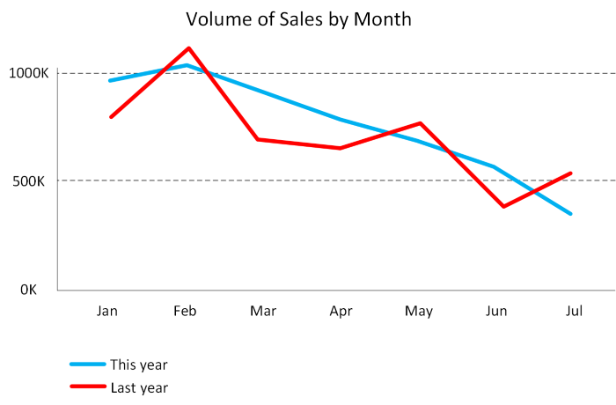
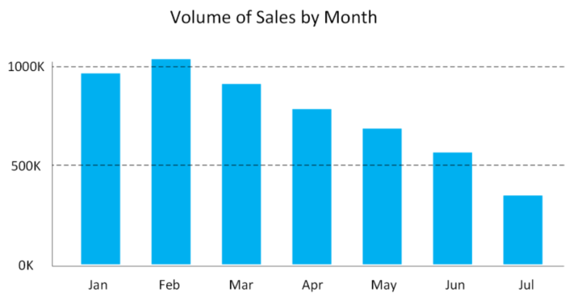
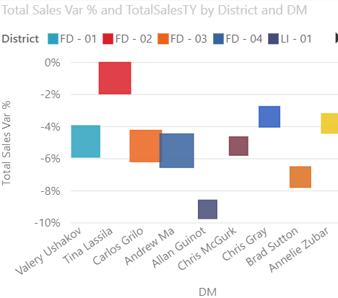
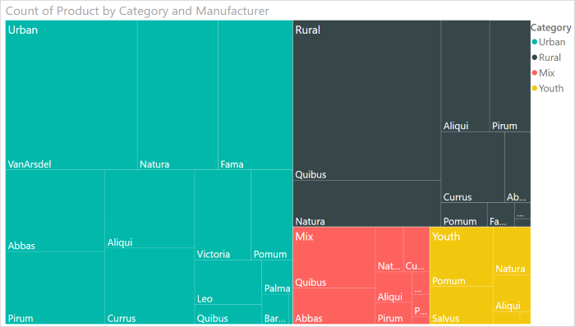
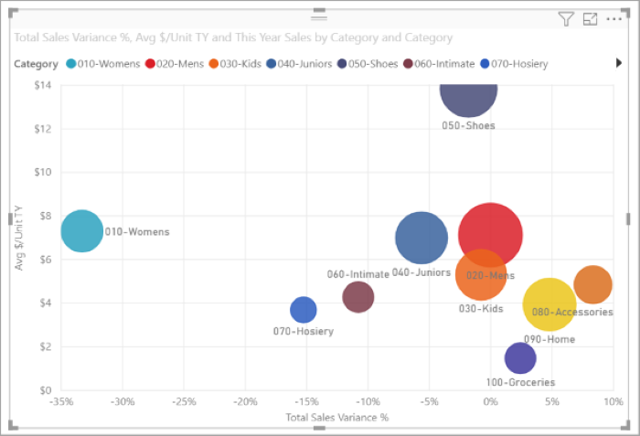
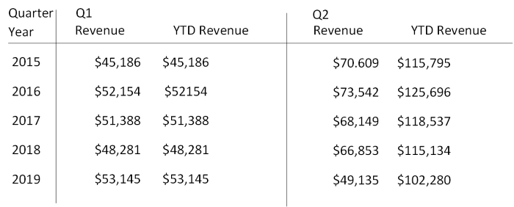
Power BI
Visualizations
Notes:
Instructor notes
Some examples of the many types of visualizations available in Power BI.

Slide 59
Explore data analytics
Descriptive
Diagnostic
Predictive
Prescriptive
Cognitive
Notes:
Instructor notes
Descriptive Analytics
The world of analytics, is evolving from the typical “Descriptive Analytics”, which is all about – What is happening in my business?
Diagnostic Analytics
The data insights, provided by descriptive analytics, are needed to provide the answer to: , “Why it is happening in your business”, which is often referred to analyzing root cause, or “Diagnostic Analytics”
Both, Descriptive and Diagnostic Analytics, is seen as a workload which is primarily providing a reactive response --- from what is happening, why is it happening, to what I am I going to do about it?
Predictive Analytics
By building out predictive patterns on top of your data, by utilizing the data findings from Descriptive, Diagnostic and Predictive data, you’ll be able to identify what is based on what you get from descriptive and diagnostic analytics and used to find answers to the question of what is likely to happen in the future based on previous trends and patterns?
Prescriptive Analytics
Techniques used to provide a predictive insights into your data, is commonly introduced by building out machine learning models, to “predict” trends and give the answer to the very
When you get the findings from Descriptive, Diagnostic and Predictive analytics like what’s happened, the root cause behind that and what-might-happen in future, Prescriptive model utilizes those answers to help you determine the best course of action to choose to bypass or eliminate future issues.
Cognitive Analytics
Cognitive analytics combines a number of intelligent technologies like artificial intelligence, machine-learning algorithms, deep learning etc.to apply human brain like intelligence to perform certain tasks. Basically, this type of analytics is inspired by how the human brain processes information, draws conclusions and codifies instincts and experience into learning such as understanding not only the words in a text but the full context of what is being written or spoken.

Slide 60




What is modern data warehousing?
Ingest & Prep
Model & Serve
Visualize
Azure Data Factory
Azure Synapse Analytics
(Data Warehouse)
Power BI
Code-free data transformation and ingestion from 90+ data integration connectors
Leader in the Magic Quadrant for Business Intelligence and Analytics Platforms*
Up to 14x faster and costs 94% less than other cloud providers
Azure Databricks (Data prep)
Up to 10x faster than vanilla Spark
Store
Azure Data Lake Storage
High performance data lake available in all 54 Azure regions
Notes:
Instructor notes
A modern data warehouse might contain a mixture of relational and non-relational data, including files, social media streams, and Internet of Things (IoT) sensor data.
Azure provides a collection of services you can use to build a data warehouse solution, including Azure Data Factory, Azure Data Lake Storage, Azure Databricks, Azure Synapse Analytics, and Azure Analysis Services.
You can use tools such as Power BI to analyze and visualize the data, generating reports, charts, and dashboards.

Slide 61
Combine batch and stream processing
Ingest & Prep
Model & Serve
Visualize
Azure Data Factory
Azure Synapse Analytics
(Data Warehouse)
Power BI
Logs (unstructured)
Code-free data transformation and ingestion from 90+ data integration connectors
Leader in the Magic Quadrant for Business Intelligence and Analytics Platforms*
Up to 14x faster and costs 94% less than other cloud providers
Media (unstructured)
Azure Databricks (Data prep)
Up to 10x faster than vanilla Spark
Files (unstructured)
Store
Azure Data Lake Storage
Business/custom apps (structured)
High performance data lake available in all 54 Azure regions
Notes:
The data sources on the left will include live data such as stock market data which will be streamed instantly.
There will also be data coming from historical sources such as past sales. This data could be loaded monthly.
A third type of data would be live sales. This can be streamed instantly as well as loaded as a batch into the historical sales data.
You should run through the paths that data can take including, for example:
Completely live data could come from a log, to Azure Data Factory to be prepped, to Synapse analytics to be modelled, to Power BI to be Visualized.
Live sales data could come from an app, to Azure Data Factory to be prepped, to Synapse analytics to be modelled, to Power BI to be Visualized.
Periodically sales data is ingested by Databricks and stored in Data Lake. This data is combined with live data by Synapse Analytics to compare live and historical data in Power BI.

Slide 62
What is Azure Data Lake storage?
A repository of data for your Modern Data Warehouse
Organises data into directories for improved file access
Supports POSIX and RBAC permissions
It is compatible with Hadoop Distributed File System
Store
Azure Data Lake Storage
High performance data lake available in all 54 Azure regions
Notes:
Instructor notes
A data lake is a repository for large quantities of raw data. Because the data is raw and unprocessed, it's very fast to load and update, but the data hasn't been put into a structure suitable for efficient analysis.

Slide 63
What is Azure Databricks?
Apache Spark-based platform:
Simplifies the provisioning and collaboration of Apache Spark-based analytical solutions
Enterprise Security:
Utilizes the security capabilities of Azure
Integration with Azure services:
Can integrate with a variety of Azure data platform services and Power BI
Notes:
Instructor notes
Azure Databricks is an Apache Spark environment running on Azure to provide big data processing, streaming, and machine learning.

Slide 64
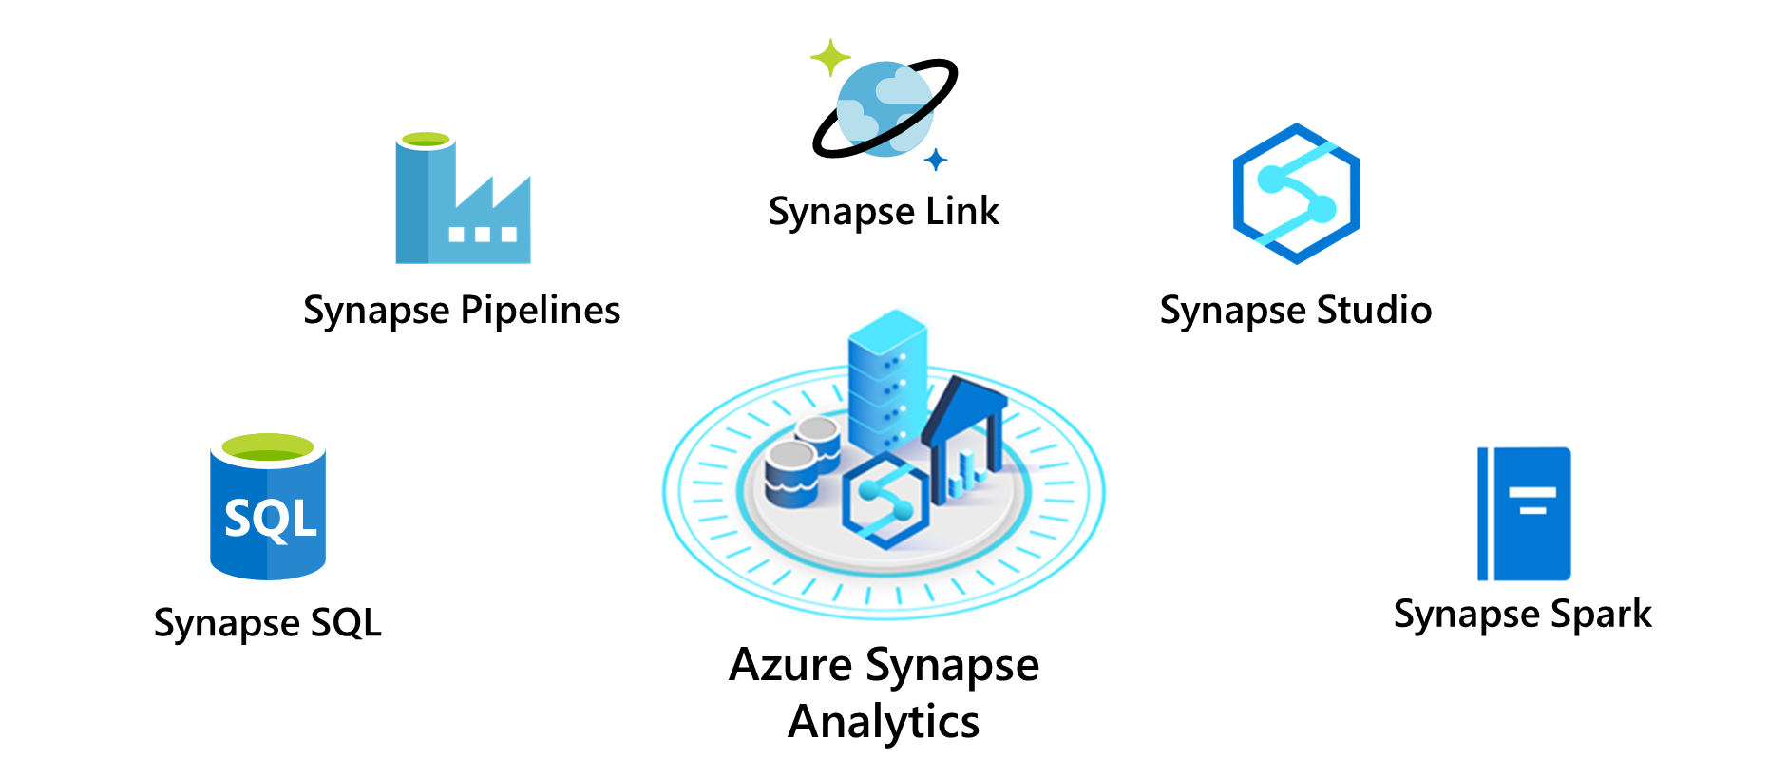
What is Azure Synapse Analytics?
Notes:
Instructor notes
Azure Synapse Analytics is an evolution of Azure SQL Data Warehouse.
Azure Synapse Analytics is an analytics engine. It's designed to process large amounts of data very quickly.
Using Synapse Analytics, you can ingest data from external sources, such as flat files, Azure Data Lake, or other database management systems, and then transform and aggregate this data into a format suitable for analytics processing.

Slide 65
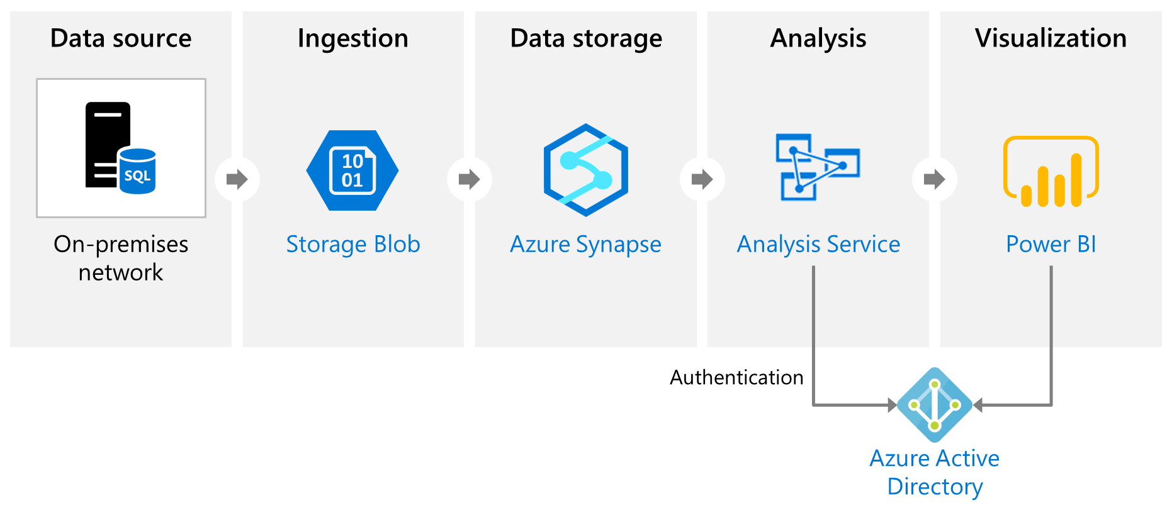
What is Azure Analysis Services?
Notes:
Instructor notes
Azure Analysis Services enables you to build tabular models to support online analytical processing (OLAP) queries.

Slide 66
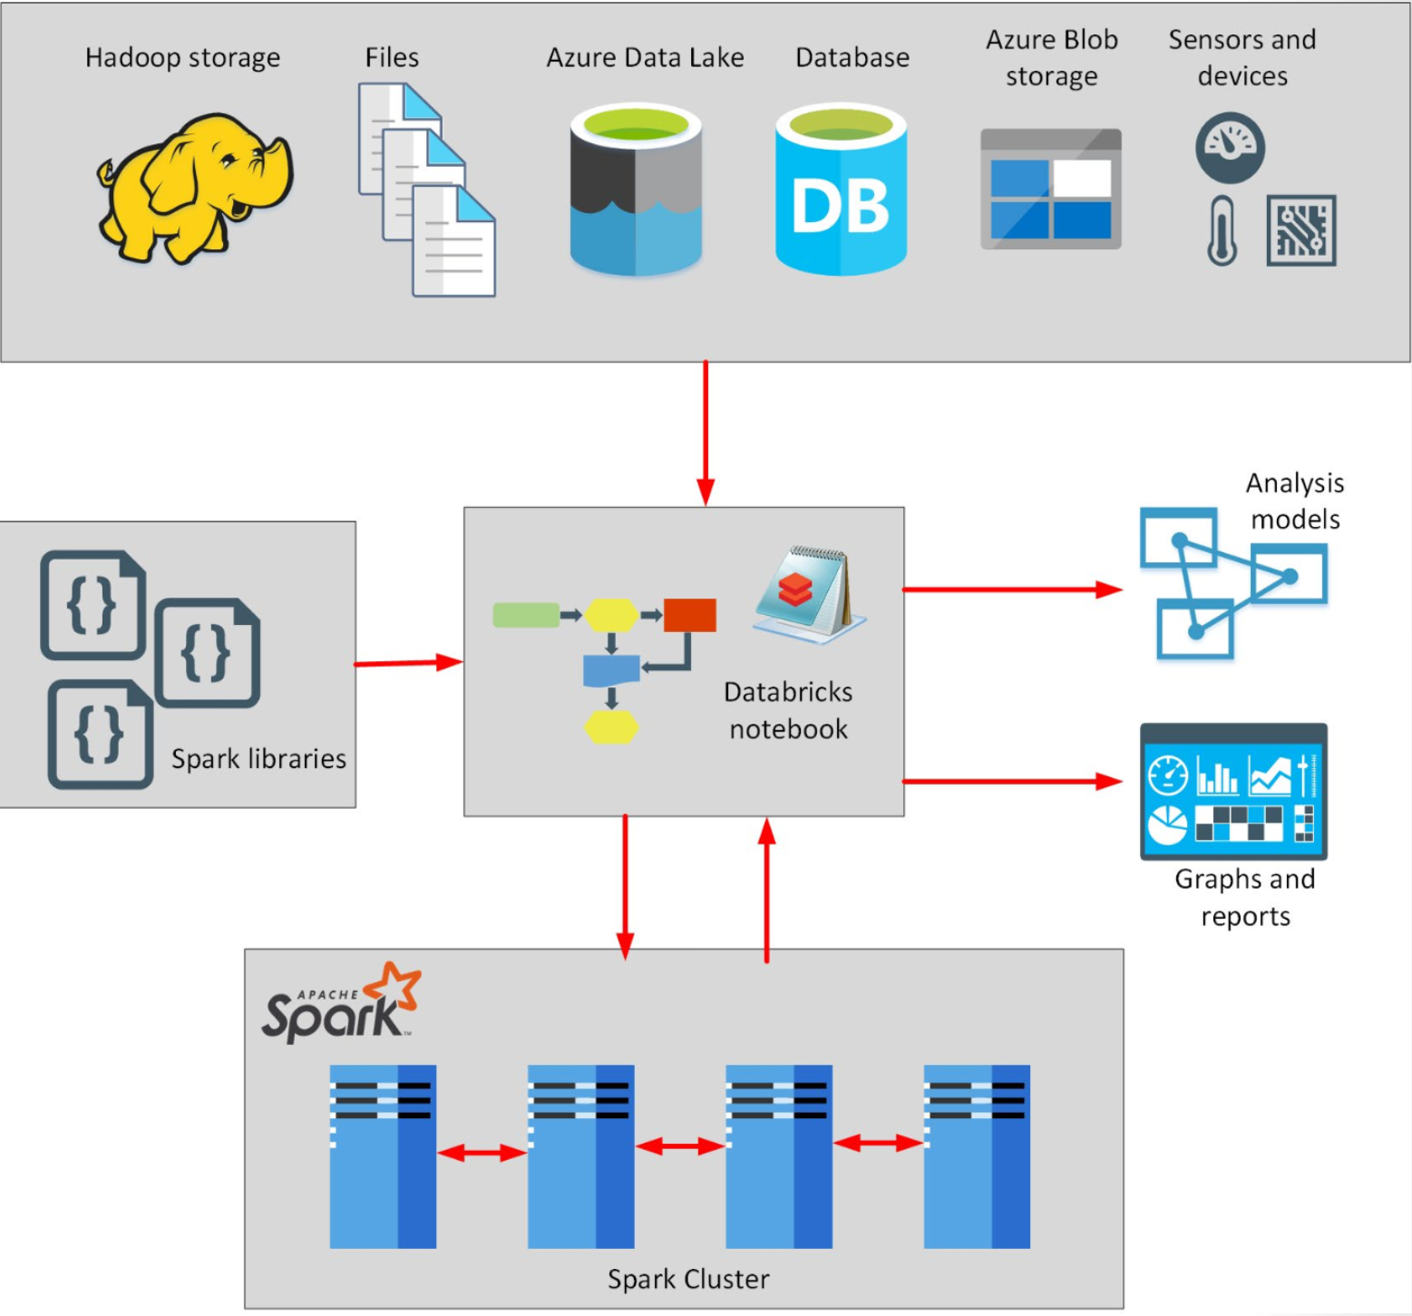
What is Azure HDInsight?
Notes:
Instructor notes
Azure HDInsight is a big data processing service, that provides the platform for technologies such as Spark in an Azure environment. HDInsight implements a clustered model that distributes processing across a set of computers. This model is similar to that used by Synapse Analytics, except that the nodes are running the Spark processing engine rather than Azure SQL Database.

Slide 67
Describe data ingestion in Azure
ADF
PolyBase
SSIS
70
100
80
Heterogenous
File based
Heterogenous
Notes:
Instructor notes
Azure Data Factory is a data ingestion and transformation service that allows you to load raw data from many different sources, both on-premises and in the cloud.
As it ingests the data, Data Factory can clean, transform, and restructure the data, before loading it into a repository such as a data warehouse. Once the data is in the data warehouse, you can analyze it.
PolyBase is a feature of SQL Server and Azure Synapse Analytics that enables you to run Transact-SQL queries that read data from external data sources. PolyBase makes these external data sources appear like tables in a SQL database.
Using PolyBase, you can read data managed by Hadoop, Spark, and Azure Blob Storage, as well as other database management systems such as Cosmos DB, Oracle, Teradata, and MongoDB.
SQL Server Integration Services (SSIS) is a platform for building enterprise-level data integration and data transformations solutions.
You can use SSIS to solve complex business problems by copying or downloading files, loading data warehouses, cleaning and mining data, and managing SQL database objects and data. SSIS is part of Microsoft SQL Server.
Databricks can process data held in many different types of storage, including Azure Blob storage, Azure Data Lake Store, Hadoop storage, flat files, SQL databases, and data warehouses, and Azure services such as Cosmos DB. Databricks can also process streaming data. For example, you could capture data being streamed from sensors and other devices.

Slide 68


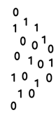


Describe components of Azure Data Factory
Linked Service
Triggers
@
Parameters
IR
Integration Runtime
Data Lake Store
Pipeline
CF
Control Flow
1
Activities
Azure Databricks
Dataset
Notes:
Instructor notes
Azure Data Factory can incorporate Azure Databricks notebooks into a pipeline. A pipeline can pass parameters to a notebook. These parameters can specify which data to read and analyze. The notebook can save the results, which the Azure Data Factory pipeline can use in subsequent activities.

Slide 69
Exam DP-900 Item Types

Slide 70

Multiple Choice

Slide 71
Repeated Scenario
You need to move an Azure VM to another hardware host.
Solution: You redeploy the VM.
Does this solution meet the goal?
Yes
No

Slide 72

Select and Place

Slide 73

Build List and Reorder

Slide 74

Active Screen/Fill in the Blank

Slide 75

Case Study

Slide 76






Performance-Based Lab

Slide 77
Microsoft Online Testing

Slide 78
Microsoft Online Testing Process
timw.info/online

Slide 79

Microsoft Online Testing Process

Slide 80

Microsoft Online Testing Process

Slide 81

Microsoft Online Testing Process

Slide 82

Microsoft Online Testing Process

Slide 83

Microsoft Online Testing Process

Slide 84

Microsoft Online Testing Process

Slide 85

Microsoft Online Testing Process

